Slide 1
COMP 2310 Data Structures and Algorithms
Lecture 9
Tree Structures – Part 2
Binary Tree Applications

Slide 2
Reminder: Binary Tree Terminology
Left Child – The left child of node n is a node directly below and to the left of node n in a binary tree.
Right Child – The right child of node n is a node directly below and to the right of node n in a binary tree.
Left Subtree – In a binary tree, the left subtree of node n is the left child (if any) of node n plus its descendants.
Right Subtree – In a binary tree, the right subtree of node n is the right child (if any) of node n plus its descendants.

Slide 3
The Height of Binary Tree
The height of a binary tree T can be defined recursively as:
If T is empty, its height is -1.
If T is non-empty tree, then since T is of the form
r
T_{L} T_{R}
the height of T is 1 greater than the height of its root’s taller subtree; i.e.
height(T) = 1 + max{height(T_{L}), height(T_{R})}

Slide 4
C++ Function for Height
// Recursive function to calculate the height of a given binary tree
int height(Node* root)
{
int lh, rh, th;
// base case: empty tree has a height of 0
if (root == null) {
return -1;
}
// recursive calls for the left and right subtrees
lh = height(root->left);
rh = height(root->right);
th = 1 + max(lh, rh);
return th;
}
//The height is returned

Slide 5
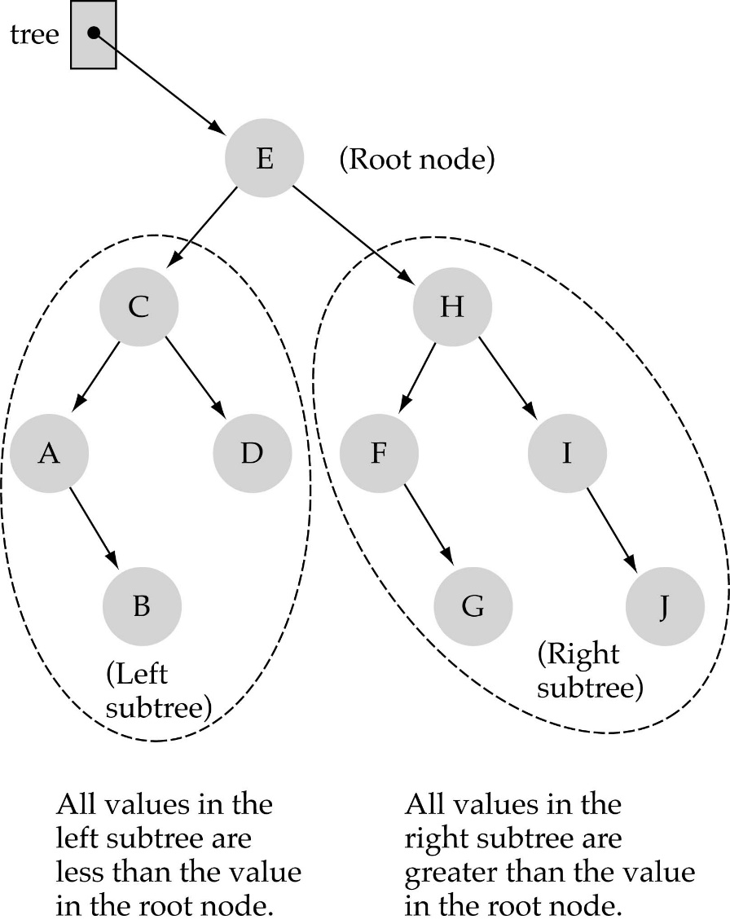
Reminder: Binary Search Trees
Binary Search Tree Property:
The value stored at any node is greater than or equal the value stored at its left child and less than the value stored at its right child.

Slide 6

How to Search a Binary Search Tree?
(1) Start at the root
(2) Compare the value of the item you are searching for with the value stored at the root
(3) If the values are equal, then item found; otherwise, if it is a leaf node, then not found

Slide 7

How to search a binary search tree?
(4) If it is less than the value stored at the root, then search the left subtree
(5) If it is greater than the value stored at the root, then search the right subtree
(6) Repeat steps 2-6 for the root of the subtree chosen in the previous step 4 or 5

Slide 8

How to search a binary search tree?
Is this better than searching a linked list? (O(N))
Yes !! ---> O(logN)

Slide 9
Searching for a Value in a BST: Iterative Pseudocode
Pseudocode can be written iteratively as follows:
Initially, x is a pointer to the root and key[x] is the value stored in node x . We are searching for the given value k.
//Pointer to the node that contains k is returned
ITBST_SEARCH(x, k)
while x ≠ NULL and k ≠ key[x] //Continue if both true, return if one fails
if k < key[x]
x ← left[x]
else
x ← right[x]
return x
// If returns NULL, not found, otherwise found in current node, x.
Notes:
9

Slide 10
Searching a BST: Recursive Pseudocode
A recursive pseudocode for tree search :
//Pointer to the node that contains k is returned
RBST_SEARCH(x, k) //x is the root address
if x=NULL or k=key[x]
return x
if k<key[x]
return RBST_SEARCH(left[x], k)
else
return RBST_SEARCH(right[x], k)
How to Call: RBST_SEARCH(Root[T],v)
(v is the search value at the call point.)
Notes:
10

Slide 11
Searching for the Minimum in a BST
The minimum value stored in a node in a BST can always be found by following the left child pointers from the root until a NULL is reached.
7 → 3 → 1
Runing time (Worst case): O(h)
h=log₂ n (the height of the tree)
7
3
9
1
5
8
10
4
Notes:
11

Slide 12
Searching for the Minimum in a BST
Pseudocode: Searching for the minimum.
(key[x] is the value stored in a node x)
//The node that contains the min is returned
BSTREE_MINIMUM(x)
while left[x] ≠ NULL
x ← left[x]
return x
Notes:
12

Slide 13
Searching for the Maximum in a BST
The maximum value stored in a node in a BST can always be found by following the right child pointers from the root until a NULL is reached.
7 → 9 → 10
Running time: O(h), h=log₂ n (The height of the tree)
7
3
9
1
5
8
10
4
Notes:
13

Slide 14
Searching for the Maximum in a BST
Pseudocode: Search for the maximum.
//The node that contains the max is returned
BSTREE_MAXIMUM(x)
while right[x] ≠ NULL
x ← right[x]
return x
Notes:
14

Slide 15
Insertion into a BST
To insert a new node z into tree T:
1.Descend down the tree until the last node on the path (Leaf).
2.Insert the new node there as a leaf.
Running time: O(h)
7
3
9
1
5
8
10
4
6
Inserting an item with key 6
Notes:
15

Slide 16
BST Insertion: Method
Goal:
Insert value v into a given binary search tree
Informal method for every node:
If v>key[x] move to the right child of x,
else move to the left child of x. Update x as the current node.
When x is NULL, we found the correct position
If v <= key[y] insert the new node as y’s left child
else insert it as y’s right child
What is y here ?
Beginning at the root, go down the tree and maintain:
Pointer x : traces the downward path: current node
Pointer y : parent of x (“trailing pointer” )
Insert value v=13
12
5
18
2
9
15
19
1
3
13
17

Slide 17
BST Insertion: Iterative Algorithm
// T is the root, z is the new node to be inserted. left[z]=right[z] = NULL, key[z]=v
BSTREE_INSERT(T, z) z
y ← NULL //Parent
x ← root [T]
while x ≠ NULL // searches for the place to insert z, maintaining parent y.
do y ← x // Both x and y move down T
if key[z] < key[x] EX: Insert 13
then x ← left[x]
else x ← right[x] // End while
if y = NULL // T was empty
then root[T] ← z // z is the root
else
if key[z] < key[y] // Insert to left or right?
then left[y] ← z
else right[y] ← z
v
12
5
18
2
9
15
19
1
3
13
17
Notes:
17

Slide 18
BST Insertion: Iterative Algorithm
using namespace std;
struct Node {
int key;
struct Node *left, *right;
};
Node* newNode(int data)
{
Node* temp = new Node;
temp->key = data;
temp->left = NULL;
temp->right = NULL;
return temp;
}
Notes:
18

Slide 19
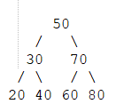
BST Insertion: Iterative Algorithm
Node* insert(Node* root, int key)
{
Node* newnode = newNode(key);
Node* x = root;
Node* y = NULL;
while (x != NULL) {
y = x;
if (key < x->key)
x = x->left;
else
x = x->right;
}
if (y == NULL)
y = newnode;
else if (key < y->key)
y->left = newnode;
else
y->right = newnode;
return y;
}
int main()
{
Node* root = NULL;
root = insert(root, 50);
insert(root, 30);
insert(root, 20);
insert(root, 40);
insert(root, 70);
insert(root, 60);
insert(root, 80);
return 0;
}
Notes:
19

Slide 20
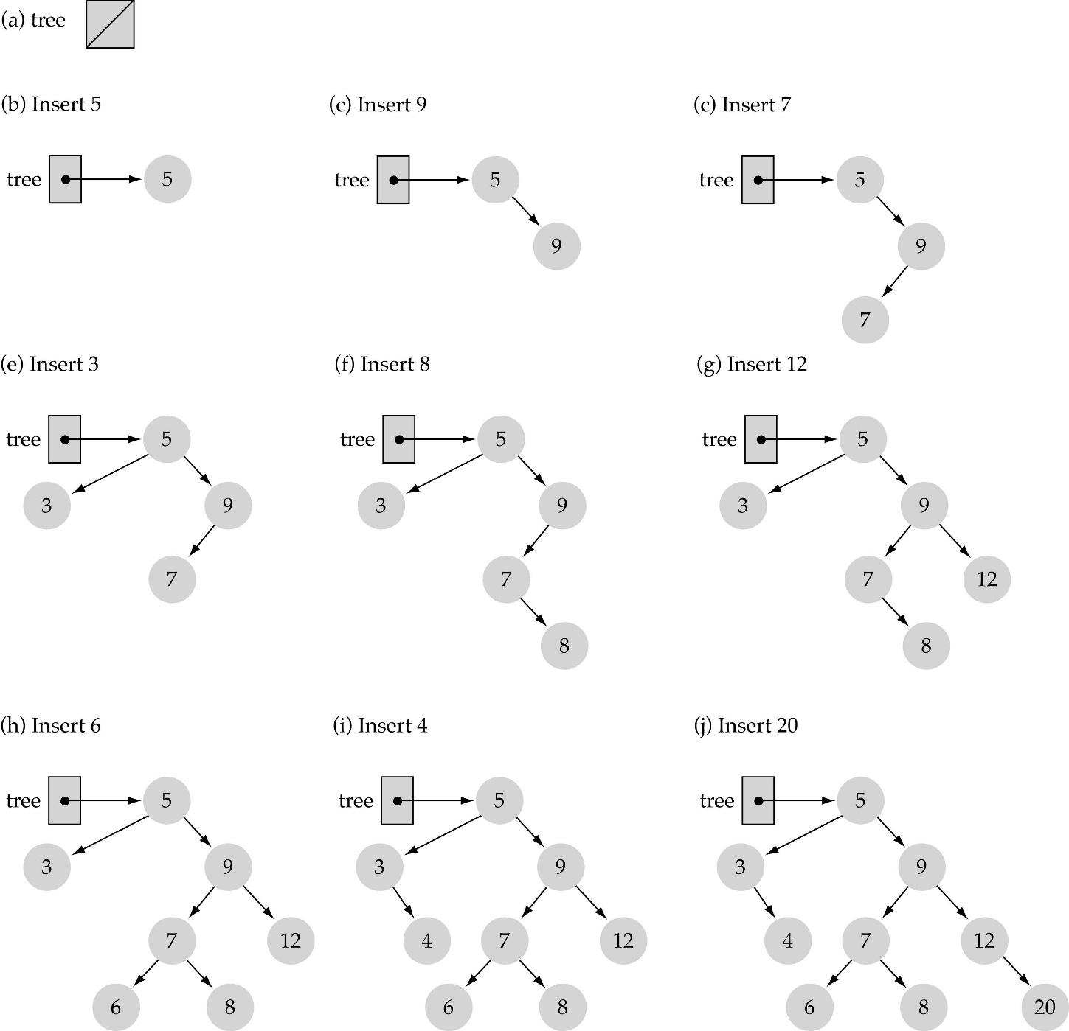
Building the tree: 5, 9, 7, 3, 8, 12, 6, 4, 20
Example
Use the binary search tree property to insert the new item at the correct place
→Call BSTREE_INSERT(..)

Slide 21
Run Time Analysis of BST Insertion
Initializations: O(1)
While loop: Searches for place to insert z, maintaining parent address y. This takes O(h) time.
Last part : Insert the value: O(1)
TOTAL: O(h)+1
= O(h) time to insert a node.
= O(log₂n)

Slide 22
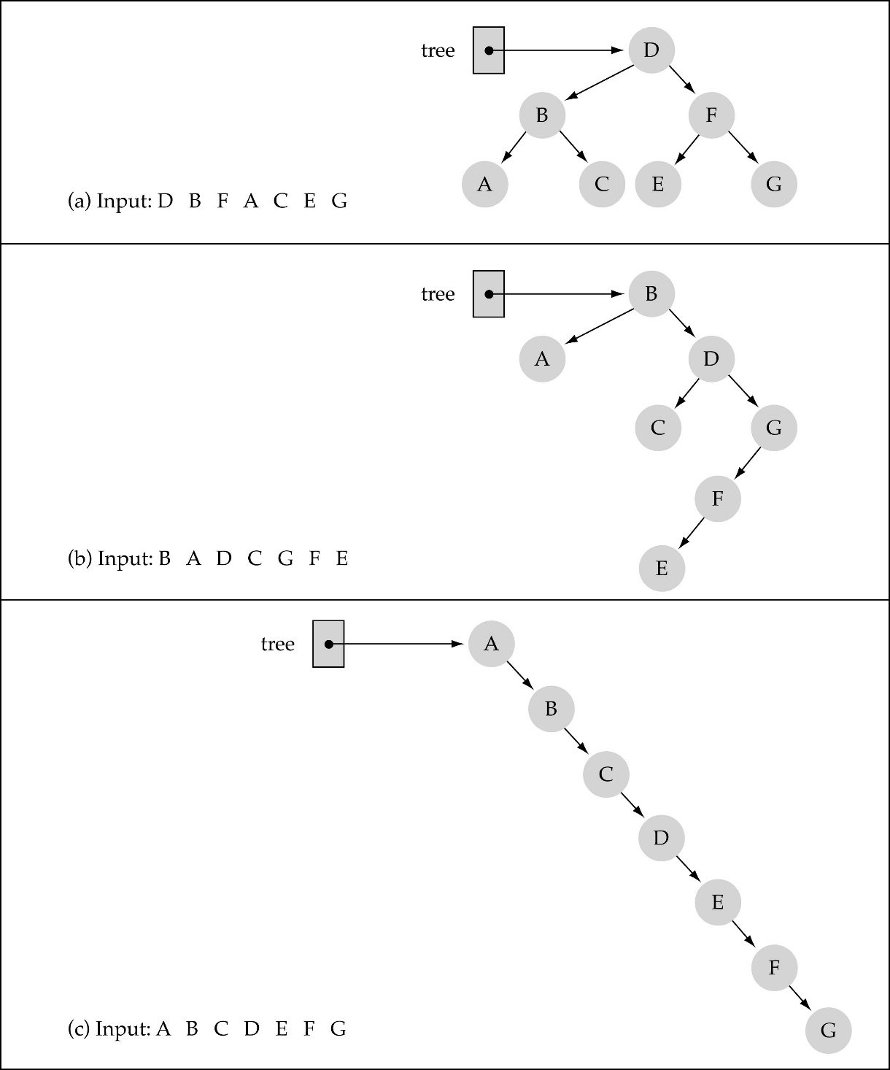
Does the order of inserting elements into a tree matter?
Yes!
Certain orders might produce very unbalanced trees!

Slide 23
BST Tree Delete
Deleting a node is also a very common tree operation.
Deletion is performed in such a way that, the inorder traversal ordering should be the same for the remaining nodes after deletion.
There are three possibilities(Cases):
1. If x has no children (Leaf) ♦ case 1
then remove x
2. If x has one child ♦ case 2
then make p[x] (Parent of x) point to child
3. If x has two children (subtrees) ♦ case 3
then swap x with its inorder successor
perform case 1 or case 2 to delete it
Complexity of deletion is also O(h).

Slide 24
BST Delete: Case 1
Deleting a node z from a BST.
Case 1: z has no children.
Ex: z=10, remove it
7
7
3
9
3
9
1
5
8
10
1
5
8
Inorder Traversal: Before :1 3 4 5 6 7 8 9 10 After :1 3 4 5 6 7 8 9 -
4
6
4
6
Notes:
24

Slide 25
BST Delete: Case 2
Deleting a node z from a BST.
Case 2:
z=7 has only one child. Ex: link 9 (child) to 6 (its ancestor)
6
6
Before:1 2 3 4 5 6 7 8 9 10 After :1 2 3 4 5 6 8 9 10
2
7
2
9
1
4
9
1
4
8
10
3
5
8
10
3
5
Notes:
25

Slide 26
BST Delete: Case 3
Deleting a node z from a BST.
Case 3: z has two chidren. Ex: z = 3, transfer the inorder successor to deletion position (pos. of z) and link the children of successor to their grand parents.
7
7
3
8
4
8
1
6
10
1
6
10
4
5
9
11
9
11
Successor
of 3
5
Inorder:1 3 4 5 6 7 8 9 10 11 Inorder:1 4 5 6 7 8 9 10 11
Notes:
26

Slide 27
BST Delete
// Check if the node to be deleted has at most one child.
if (curr->left == NULL || curr->right == NULL) {
Node* newCurr;
if (curr->left == NULL)
newCurr = curr->right;
else
newCurr = curr->left;
if (prev == NULL)
return newCurr;
if (curr == prev->left)
prev->left = newCurr;
else
prev->right = newCurr;
delete curr;
}
Node* deleteIterative(Node* root, int key)
{
Node* curr = root;
Node* prev = NULL;
while (curr != NULL && curr->data != key) {
prev = curr;
if (key < curr->data)
curr = curr->left;
else
curr = curr->right;
}
if (curr == NULL) {
cout << "Key " << key << " not found in the"
<< " provided BST.\n";
return root;
}
Notes:
27

Slide 28
BST Delete
// node to be deleted has two children.
else {
Node* p = NULL;
Node* temp;
// Compute the inorder successor
temp = curr->right;
while (temp->left != NULL) {
p = temp;
temp = temp->left;
}
if (p != NULL)
// if right child of curr has left child
p->left = temp->right;
else
// if right child of curr has no left child
curr->right = temp->right;
curr->data = temp->data;
delete temp;
}
return root;
}
Notes:
28

Slide 29
Balancing a Binary Tree
Search processes are much faster than linked lists if the tree is well balanced.
Efficiency of the search process depends how the tree looks like.
Worst case may approach to O(n) in some cases! (Why?)
What do we mean by balancing a tree?
→The left or right subtree at any node should have similar shape and height. How similar?
The answer is “Height balanced tree”.
Notes:
29

Slide 30
Height-Balanced Trees
A height-balanced tree is a binary search tree such that:
The height of the left and right subtrees of the root differ by at most 1
The left and right subtrees of the root are also height balanced trees
Remember that every node is the root of its subtrees!
Height balanced trees are also called AVL trees
(Named after two computer scientists: Adelson-Velsky and Landis)

Slide 31
Balancing a Binary Search Tree
B
E
M
B
M
E
S
M
R
B
R
T
E
S
S
Three BSTs with the same information contents
Heights are: 2, 3 and 5
R
T
T
Notes:
31

Slide 32

Balancing a Tree
A binary tree is balanced if the differences of the heighs of its two subtrees are less than or equal to 1.
For node M the difference between the height of its subterees is 1 hence the corresponding subtree is balanced.
For node B the difference between the height of its subterees is 3 hence the corresponding (sub)tree is not balanced.
B
M
E
R
S
T
Notes:
32

Slide 33
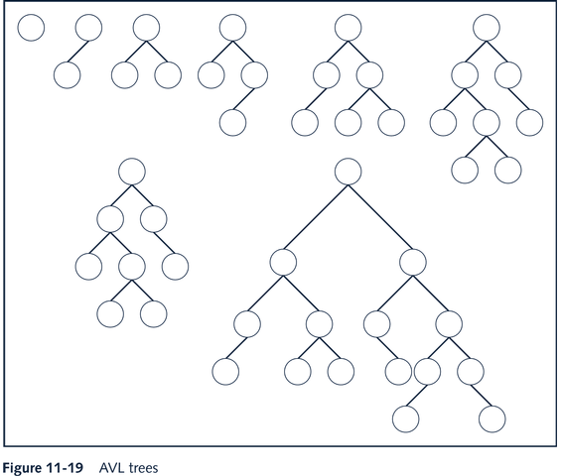
AVL (Balanced) Tree Examples

Slide 34
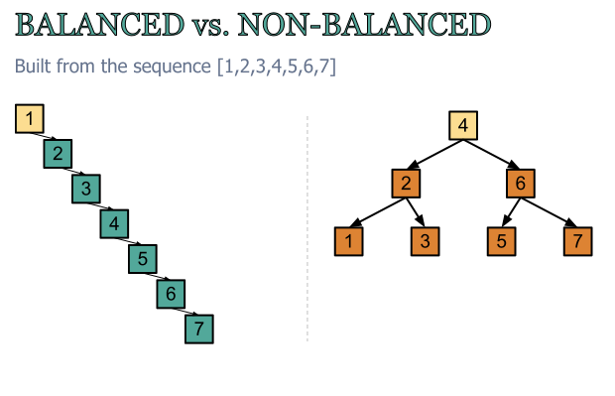
h=6 h=2
Both has the same data, but what about search complexity?

Slide 35
Why Balancing is Important ?
Maximum number of key comparisons for retrieval, deletion, and insertion operations for BSTs is determined by the height of the tree.
Suppose that n = 1000000 items are stored in a perfectly balanced tree.
The height of this tree would be
which means that at most 20 items needs to be tested to
search for an element.
The number of comparisons is much smaller than that of the linked lists.
This is why we want to balance the BSTs.
$$h=\log_{2}{n}=\log_{2}{1000000}≈19,9315$$
≈20
→ Complexity is logarithmic
Notes:
35

Slide 36
Balancing a Tree
Various methods have been developed to balance a binary tree.
Some of them is based on reordering the data when an element is entered.
Some others consist of restructring the tree for each inserted element.
In this section we consider a simple technique based on ordering the data:
First, the data is sorted in increasing order
The middle element is chosen to be the root.
Recursively, the middle elements of the left and right subtrees are chosen to be the left child and the right child respectively.
Notes:
36

Slide 37
Balancing a Tree: Example
4
2
10
Consider the data in the nodes:
4 2 10 1 3 9 8 6 5 7
Balance this tree by choosing the middle element (Median) as the root recursively.
1
3
9
8
6
5
7
Notes:
37

Slide 38
Balancing a Tree
First sort the data.
The sorted list is:
1 2 3 4 5 6 7 8 9 10
5
2
8
Step 1: 1 2 3 4 5 6 7 8 9 10
Step 2: 1 2 3 4 5 6 7 8 9 10
1
3
6
9
Step 3: 1 2 3 4 5 6 7 8 9 10
Step 4: 1 2 3 4 5 6 7 8 9 10
Step 5: 1 2 3 4 5 6 7 8 9 10
4
7
10
Step 6: 1 2 3 4 5 6 7 8 9 10
Step 7: 1 2 3 4 5 6 7 8 9 10
Notes:
38

Slide 39
Complexity of the BST Operations
Remember that, a BST with worst-case structure (degenerate tree) is no more efficient than a regular linked list.
If a BST is balanced, then the length of longest path is log n, which is the height h.
Search, Insert, Delete operations visit the nodes along a root-to-leaf path.
Therefore for balanced BSTs, inserting, locating, or deleting an element takes O(log(n)) time in the worst case.

Slide 40
Tree Applications-1: Treesort
We can use a binary search tree to sort an array or list.
Problem: Sort n integers in an array A into ascending order.
Informal method:
1.Insert the array’s elements into a BST.
2.Traverse BST in inorder. During traversal, copy data items into successive locations of another array B.
→The values in B are sorted.

Slide 41
Treesort
// Sorts n integers in an array A
Sort (A,n)
for i ← 1 to n
BSTREE_INSERT (T,A[i]) //Create the BST
INORDER_TRAVERSAL(T) // Perform inorder traversal
// At visit, insert the data value into the new array B

Slide 42
Complexity of Treesort
Inserting an item into a binary search tree:
Worst Case: O(n)
Average Case: O(log₂n)
Inserting n items into a binary search tree:
Worst Case: O(n²) T(n)=1+2+...+n = O(n²)
Average Case: O(n*log₂n)
Inorder traversal and copy items back into array: O(n)
Thus, treesort is
→ O(n²) in worst case, and
→ O(n*log₂n) in average case.
The same complexity as Quicksort!
Note: Quicksort is a general purpose sorting method.
→Treesort can only be useful if the data is already stored as a BST.

Slide 43
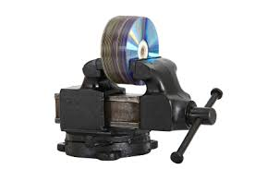

Tree Applications-2: Data Compression

Slide 44
Computer Encoding Systems
How to encode a message or text composed of a string of characters?
Codings systems used by computer implementations:
ASCII
uses 8 bits per character
can encode 2⁸=256 characters
Unicode
16 bits per character
can encode 2¹⁶=65536 characters
includes all characters encoded by ASCII
ASCII and Unicode are fixed-length codes
all characters represented by the same number of bits

Slide 45
Data Compression
In data storage and data communications, not all characters occur with the same frequency!
However, in encoding systems all characters are allocated the same amount of space. Ex: ASCII
1 char = 1 byte
Data storage and data transfer would be more efficient if we could use lesser numbers of bits for more frequently used characters.
Example: In English, E is the most common letter and Z is the least common letter.
→ Use fewer number of bits to encode E and higher number of bits for Z .

Slide 46
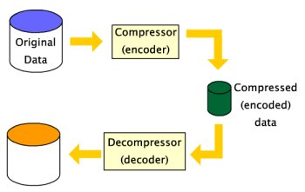
Data Compression

Slide 47
Types of Data Compression
1. Lossless – Decoding will produce exactly the original data
• we don’t loose any information by compressing it
→ But encoding will require longer codes for the data.
Good for text files.
2. Lossy - Decoded data will not be exactly the same as the original, but will be close enough
• we loose some information by encoding data
→But the encoded file will be much shorter.
• This is good for image/audio, video compression but not for text files

Slide 48
Types of Data Compression
Original Data
Compressed
Data
Encoding
lossless
Decoding
Original Data
Approximated
lossy

Slide 49
Why Compression?
Storage space and network bandwidth are limited resources. They must be used as effectively as possible.
Typically; in video, audio and image formats, most modems use compression.
Several file or data management systems automatically compress files when stored.
Data compression is also common in data communications.
All the images and video we get on the web are in fact compressed.

Slide 50
Compression Standards: Examples
Images over the web: JPEG
Music: MP3
General-purpose: ZIP, GZIP, JAR, …
jpeg is a compressed image file
mp3 is a compressed audio file
zip is a compressed archive of files

Slide 51
Data Compression
The basic idea is that instead of storing each character as an 8-bit ASCII value, we store more frequently occurring characters using fewer bits and less frequently occurring characters using more bits.
→Code word lengths are no longer fixed like in ASCII.
→Total length of the file will be shorter after compression.
We need a method for generating minimal length codes.
The method was proposed by Huffman in 1952 and applicable to many forms of data transmission and data storage.
The goal is to find optimal variable length codes for a given alphabet or any character set such as ASCII or UNICODE.

Slide 52
Compression: Example
Given text: Zoom, ASCII coding:
01011011 01101111 01101111 01110101
Requires 4*8=32 bits
Suppose we use shorter codes for m, o, Z
Z: 1101, o: 001, m: 10
Zoom : 1101 001 001 10
Now, we need only 12 bits!
When we decode this bit sequence we should get Zoom again.
Problem: How to determine the shorter codes?

Slide 53
Compression: Example
Message:
DEAACAAAAABA
Fixed length requires 12*8=96 bits
Symbol | Variable length codes
A | 0
B | 10
C | 110
D | 1110
E | 11110
DEAACAAAAABA:
1110111100011000000100
22 bits
Compressed size = 22 bits → 22/12 = 1.833 bits / symb
A common compression method is Huffman compression (1952)

Slide 54
Prefix Constraint
The codes must be unique for each character. How can we make the codes unique ?
Prefix Constraint: No code can be the prefix of any other code.
(No code can appear at the beginning of another code.)
Ex: Let A: 00, C: 11. No problem, A and C are OK.
Let B: 001. Now A, B, C are not valid! What is the problem?
What is 0000110…, is it AAC… or AB…?
Confusing, because code A is a prefix in code B.
B: 101, Would be OK.
If there is a “00” code, there cannot be a “0” code.
Huffman compression produces minimal length codes that satisfy the prefix constraint

Slide 55
Huffman Algorithm
Binary trees are used to implement Huffman compression algorithm.
Node Structure: Each node will have storage field for two data items:
The frequency of the symbol stored at that node (the weight)
The symbol associated with the node
All symbols will be stored in leaf nodes of the tree.
The weight of an interior node will be the sum of frequencies of all nodes in the subtree of that interior node.

Slide 56
Informal Huffman Algorithm
Input: Any alphabet A = {A1, A2, … , AN} and symbol frequencies
Output: optimal Huffman codes: Higher frequency → Shorter code
Sort all Symbols according to their frequencies
Begin with a forest of single node trees
each node contains a symbol and its frequency
Do recursively
select two trees with smallest frequency at the root
produce a new binary tree with the selected trees as children and store the sum of their frequencies in the root
Recursion ends when there is one tree
this is the Huffman coding tree

Slide 57
Building a Huffman Tree: Example 1
Build the Huffman coding tree for the message (or text)
AGMTEH_IS….
Assume characters (Symbols) and frequencies are as follows:
Begin with the forest of single node trees.
Order the trees according to frequencies:
A | G | M | T | E | H | _ | I | S
1 | 1 | 1 | 1 | 2 | 2 | 3 | 3 | 5
1
1
1
1
2
2
3
3
5
A
G
M
T
E
H
_
I
S

Slide 58
Building a Huffman Tree: Example 1
Combine two smallest nodes A and G.
Form a tree with left child A, right child G and frequency = 2.
2
1
1
1
1
2
2
3
3
5
A
G
M
T
E
H
_
I
S

Slide 59
Building a Huffman Tree: Example 1
Combine two smallest nodes M and T.
Form a tree with left child M, right child T and frequency = 2.
2
2
1
1
1
1
2
2
3
3
5
A
G
M
T
E
H
_
I
S

Slide 60
Building a Huffman Tree: Example 1
Combine two smallest nodes 2 and 2 and set frequency = 4.
4
2
2
1
1
1
1
2
2
3
3
5
A
G
M
T
E
H
_
I
S

Slide 61
Building a Huffman Tree: Example 1
Combine two smallest nodes E and H and set frequency = 4.
4
2
2
4
1
1
1
1
2
2
3
3
5
A
G
M
T
E
H
_
I
S

Slide 62
Building a Huffman Tree: Example 1
Now, Combine _ and I whose frequencies are smallest.
4
2
2
4
1
1
1
1
2
2
3
3
5
A
G
M
T
E
H
_
I
S

Slide 63
Building a Huffman Tree: Example 1
Combine the two trees whose frequencies are 4.
4
2
2
4
6
1
1
1
1
2
2
3
3
5
A
G
M
T
E
H
_
I
S

Slide 64
Building a Huffman Tree: Example 1
Repeat
8
4
4
2
2
2
2
6
E
H
1
1
1
1
3
3
5
A
G
M
T
_
I
S

Slide 65
Building a Huffman Tree: Example 1
Repeat
8
11
4
4
6
5
S
2
2
2
2
3
3
E
H
_
I
1
1
1
1
A
G
M
T

Slide 66
Building a Huffman Tree: Example 1
19
Final Huffman tree
8
11
4
4
6
5
S
2
2
2
2
3
3
E
H
_
I
1
1
1
1
A
G
M
T

Slide 67

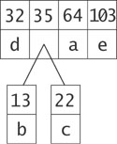
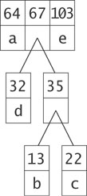
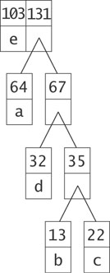
Building a Huffman Tree: Example2 The symbols and their frequencies: (b,13), (c,22), (d,32), (a,64), (e,103)
67
234
103
e

Slide 68
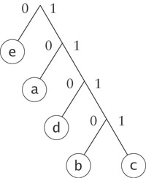
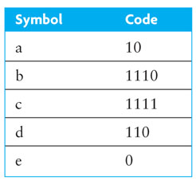
Generating Huffman codes for Example-2
Start from the root. Assign 0 (or 1) to each left move, 1 (or 0) to each right move.
A path from root to a leaf node will be the Huffman code for the symbol in that leaf node.
68
The characters in the file appear in the tree as leaf nodes. The higher their frequency in the file, the higher up they appear in the tree.

Slide 69
Generating the Huffman codes for Example-1
19
1
0
8
11
0
1
0
1
4
4
6
5
0
1
0
1
0
1
S
2
2
2
2
3
3
0
1
0
1
E
H
_
I
1
1
1
1
A
G
M
T

Slide 70
Compression by Huffman Codes: Encoding
Huffman codes are used to encode a file or message:
For each character in the original message (or file), use its code
Repeatedly append the Huffman code to the end of the coded message until it is complete.
Example using the codes for example-2: “abcdea” becomes:
1011101111110010
Compressed form uses only 2 bytes of space compared to 6 bytes of uncompressed form.
We have 1/3 of the uncompressed file size, without loss of information.

Slide 71
Compression by Huffman Codes: Decoding
Huffman tree is a kind of binary tree, it can also be used for decoding (Decompressing) compressed files or messages.
Decoding works by reading the file bit by bit
Start at the root of the tree
If a 0 is read, move left
If a 1 is read, move right
When a leaf is reached decode that character and start over again at the root of the tree
Thus, we need to save Huffman table information as a header in the compressed file
Doesn’t add a significant amount of size to the file for large files
Or we could use a fixed universal set of codes/frequencies

Slide 72
Encoding/Decoding: Example
characters codes Encode: deeda e 0 110eeda a 10 1100eda d 110 1100011010 b 1110 c 1111
Decode: 1100011010 ---- ---- d0011010 de011010 dee11010 deed10 deeda

Slide 73
Tree Applications-3: Evaluating Expressions
Node contents of a binary tree for an arithmetic expression
internal nodes: operators
leaves: operands
Order of children matches the order of operands. Such binary trees are called expression trees. Parentheses are not needed since order of operations is captured by the shape of the expression tree.
Postorder traversal Produces postfix form of the expression.

Slide 74
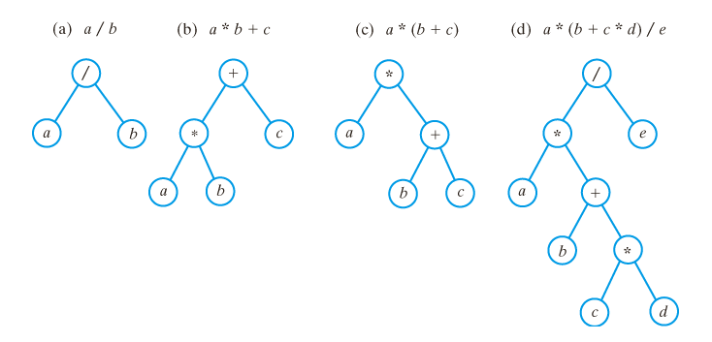
Expression Tree Examples

Slide 75
Evaluation Procedure
To evaluate a node in an expression tree
If the node is a leaf node (an operand), just return the value
Otherwise
Recursively evaluate the left subtree and get its value
Recursively evaluate the right subtree and get its value
Perform the operation indicated by the operator and return THAT value
A leaf node returns the value contained in it
An interior node evaluates its left and right subtrees, applies its operator to these values, and returns the result
This procedure uses postorder traversal and does not need precedence rules!

Slide 76
Expression Evaluation: Algorithm
Recursive algorithm for evaluating an expression tree E in postorder traversal
Evaluate ( E ) if (root of tree is operand) return operand
else firstOperand = evaluate(left subtree) // Obtain the result secondOperand = evaluate(right subtree) // Obtain the result optr = the root of expressionTree // Apply this operator at every internal node result = firstOperand optr secondOperand return result

Slide 77
Evaluation Order: Example 1
+
2
*
-
3
5
1
Based on precedence rules, we have the following order:
(2 + ( (5 – 1) * 3 )) = 14
But postorder evaluation doesn’t need the rules!
2 5 1 – 3 * + = 14

Slide 78
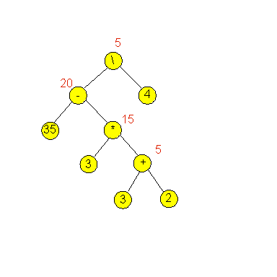
Evaluation Order: Example 2

